Slide 1

BOXEE
FOR
HACKERS
ROB SPECTRE
@BOXEE_API

Slide 2
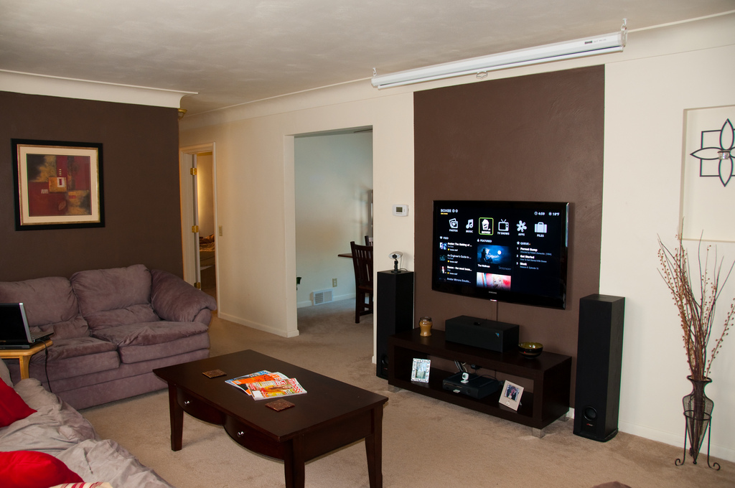

THE LIVING ROOM
MUST BE SET FREE

Slide 3
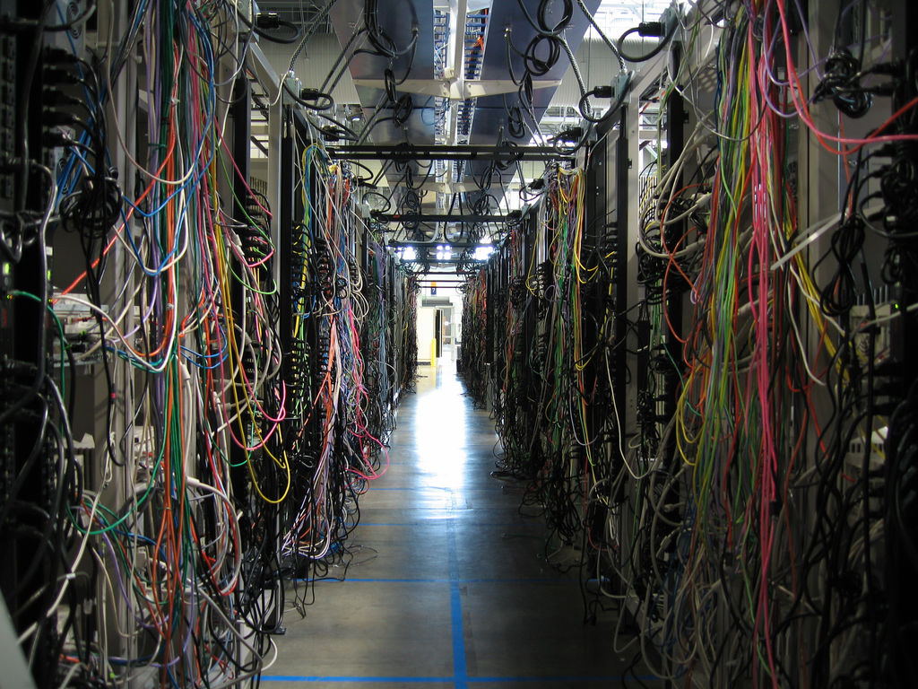
OPEN SOURCE
IS EVERYWHERE ELSE

Slide 4
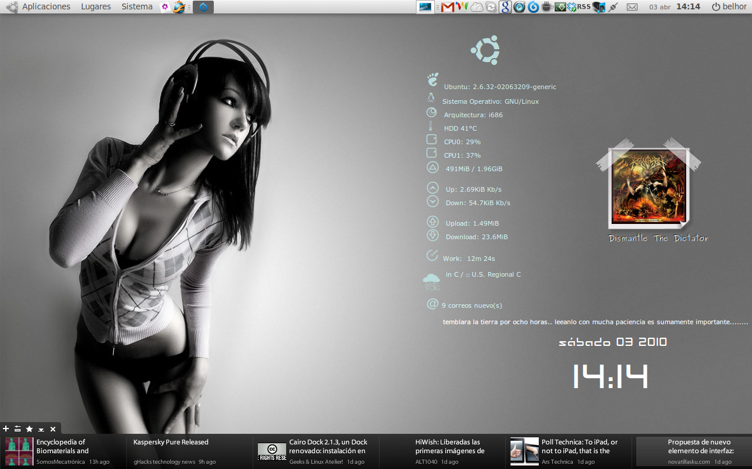
OPEN SOURCE
IS EVERYWHERE ELSE

Slide 5
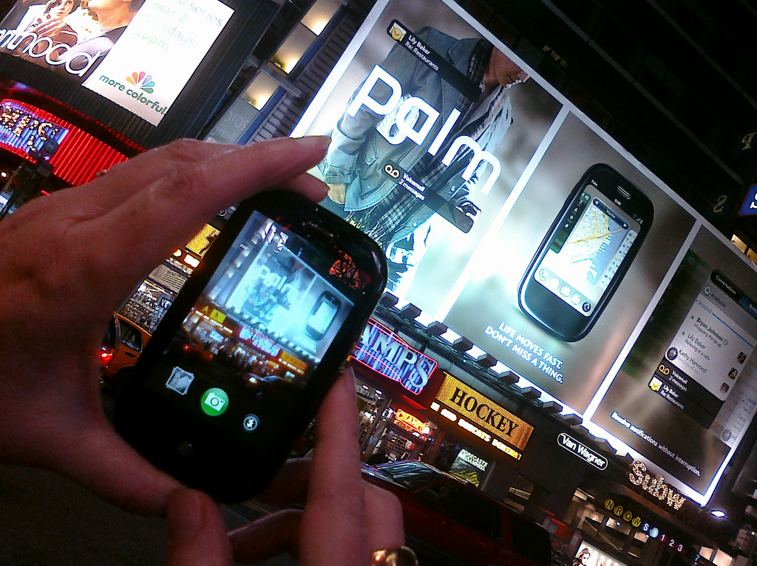
OPEN SOURCE
IS EVERYWHERE ELSE

Slide 6
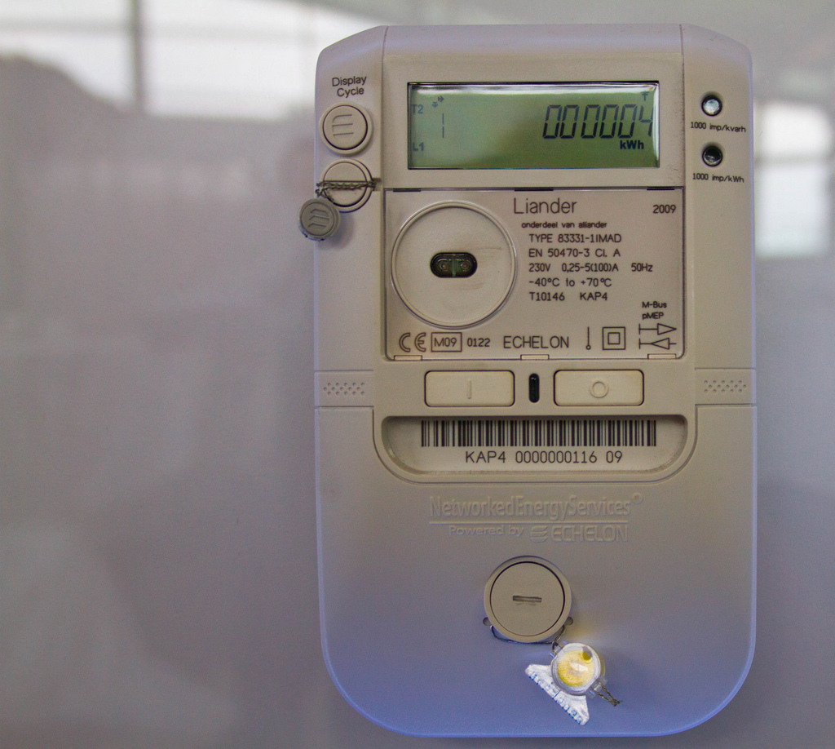
OPEN SOURCE
IS EVERYWHERE ELSE

Slide 7
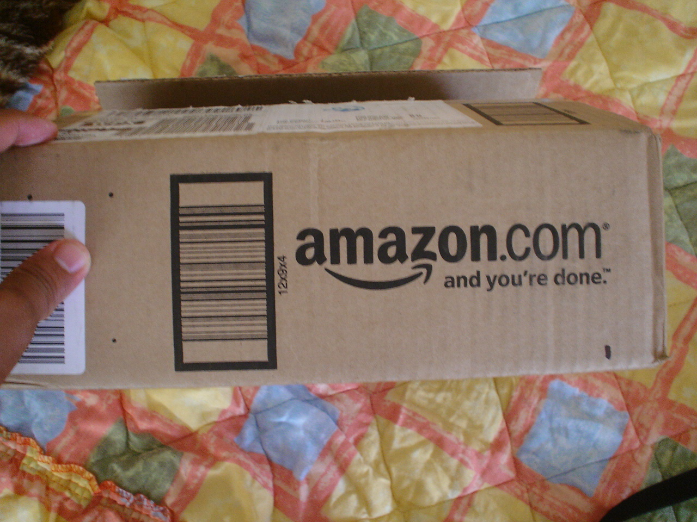
OPEN SOURCE
CHANGED COMMERCE

Slide 8
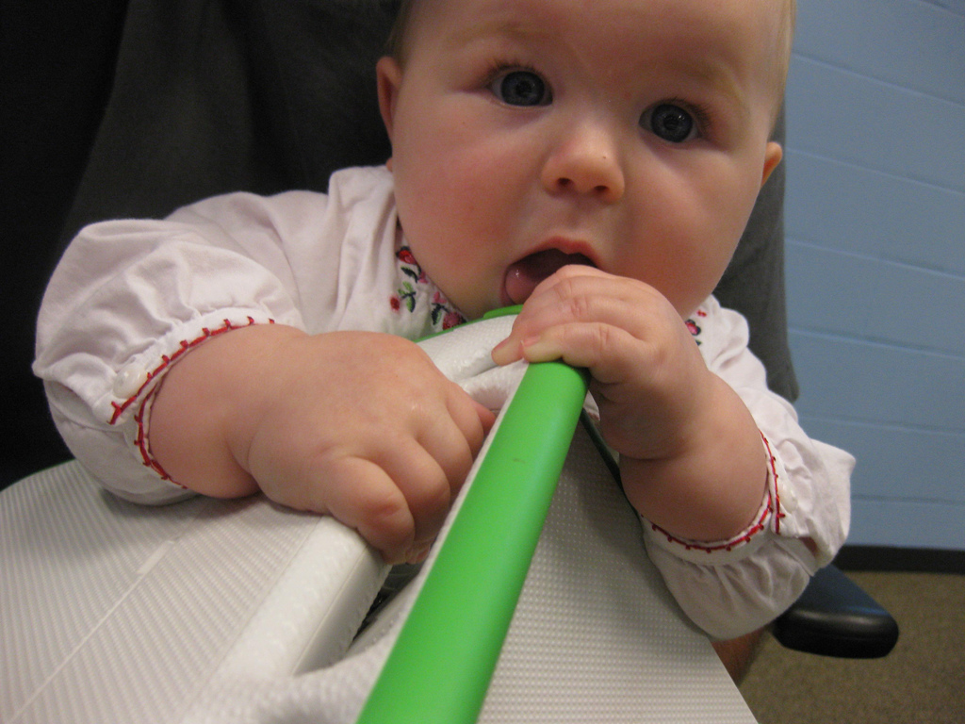
OPEN SOURCE
CHANGED EDUCATION

Slide 9
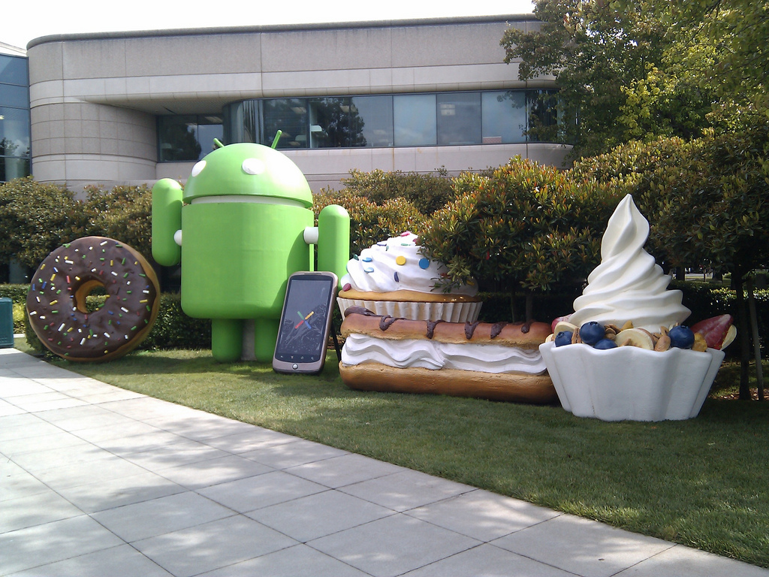
OPEN SOURCE
CHANGED COMMUNICATION

Slide 10
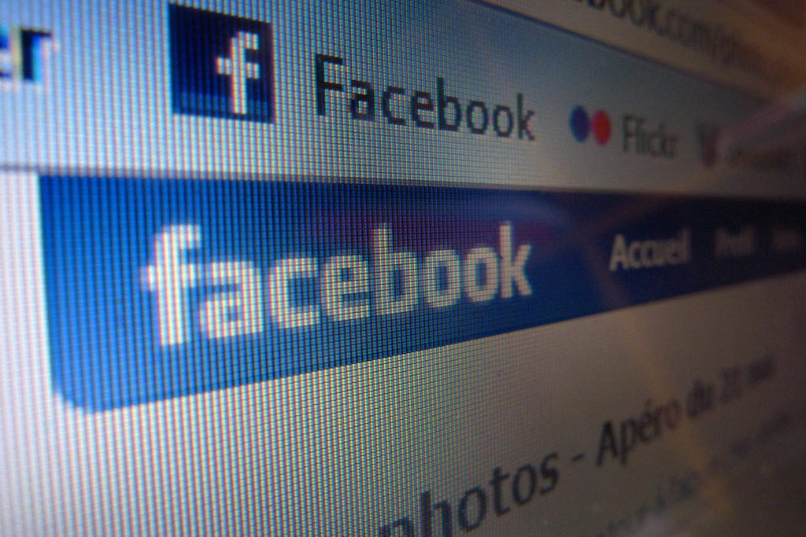
OPEN SOURCE
CHANGED RELATIONSHIPS

Slide 11
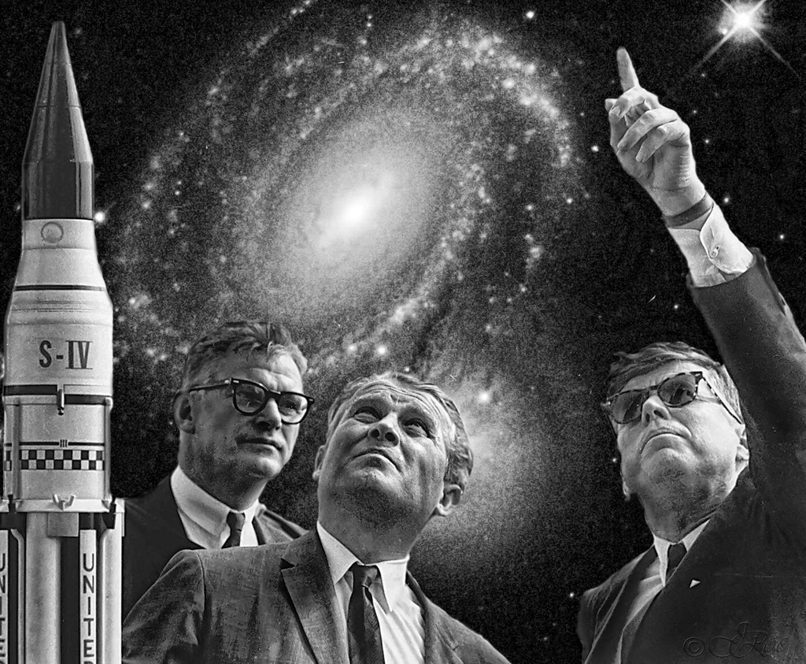
THE LIVING ROOM
IS THE FINAL FRONTIER

Slide 12
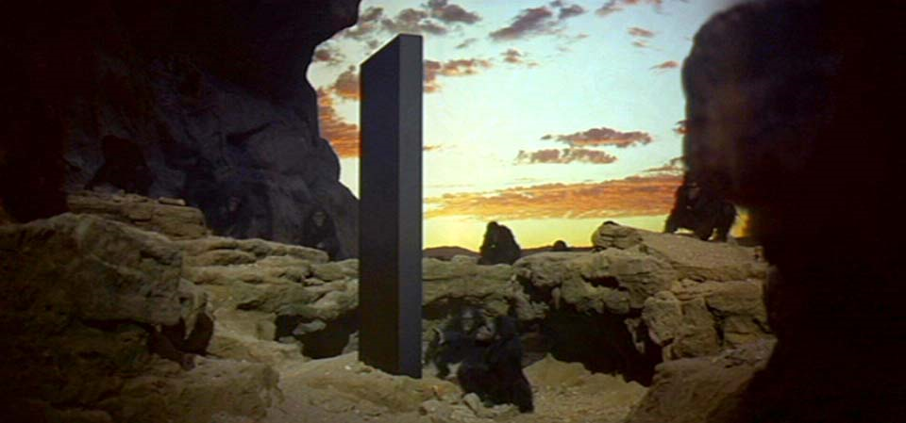
MY GOD
IT’S FULL OF HEAVY-HANDED METAPHORS

Slide 13
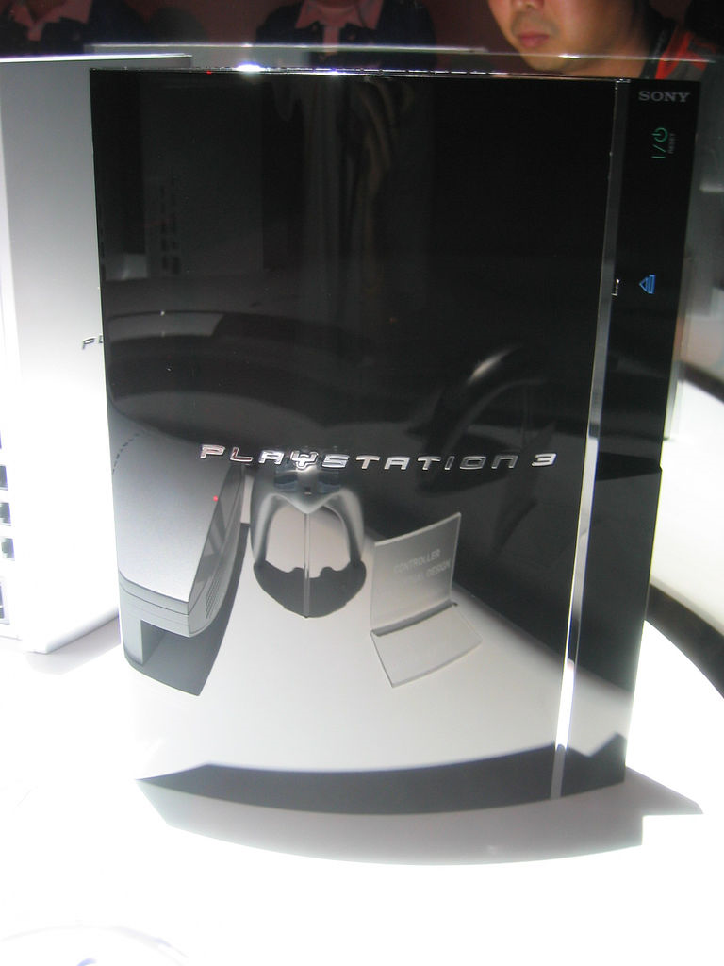
SERIOUSLY
ANOTHER 2001 ANALOGY?

Slide 14
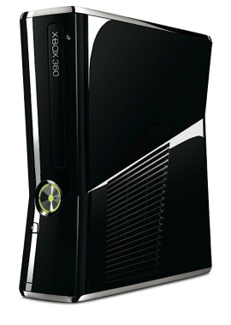
WHO DOES THIS GUY
THINK HE IS?

Slide 15
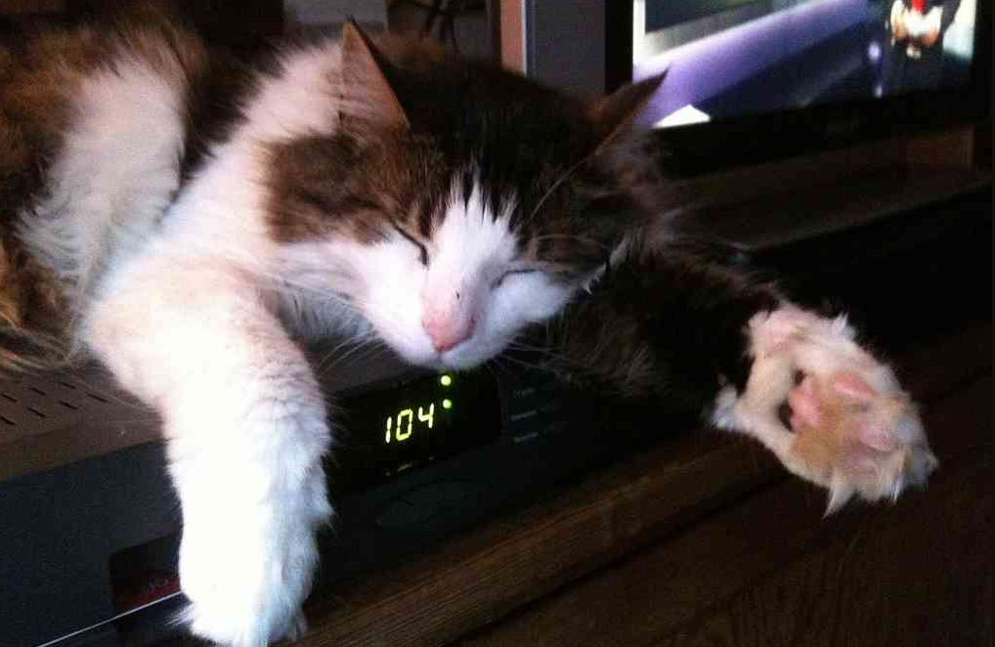
ABOUT TO FALL ASLEEP
NOT EVEN KIDDING

Slide 16
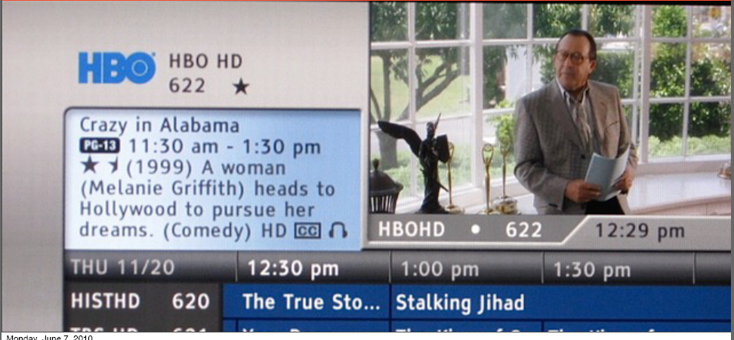
THIS INTERFACE
IS NOT AWESOME

Slide 17
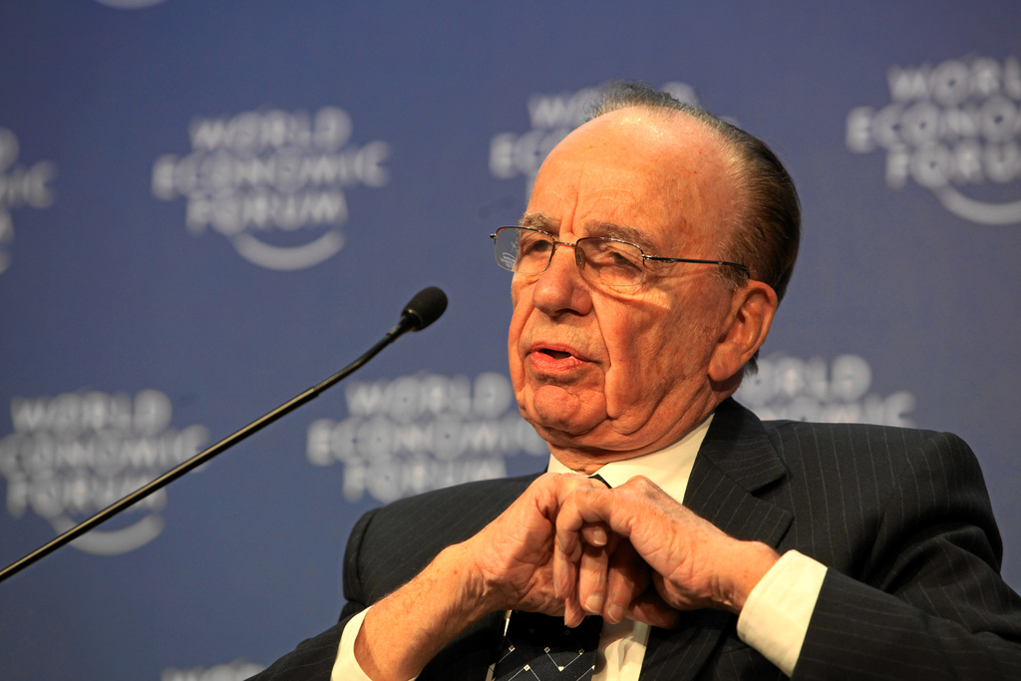
WHAT TELEVISION
LOOKS LIKE

Slide 18
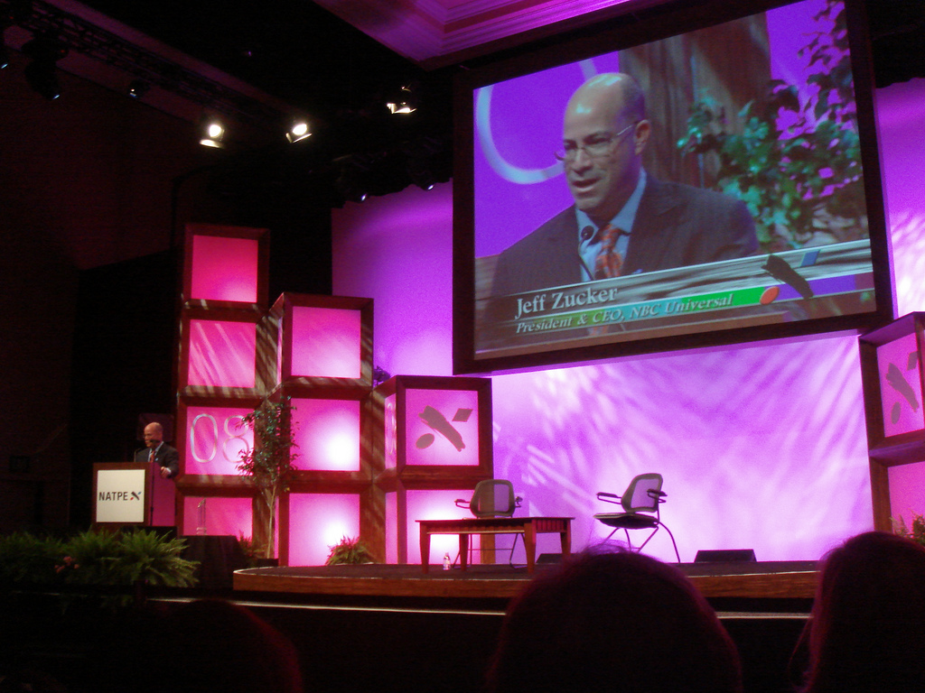
WHAT TELEVISION
LOOKS LIKE

Slide 19
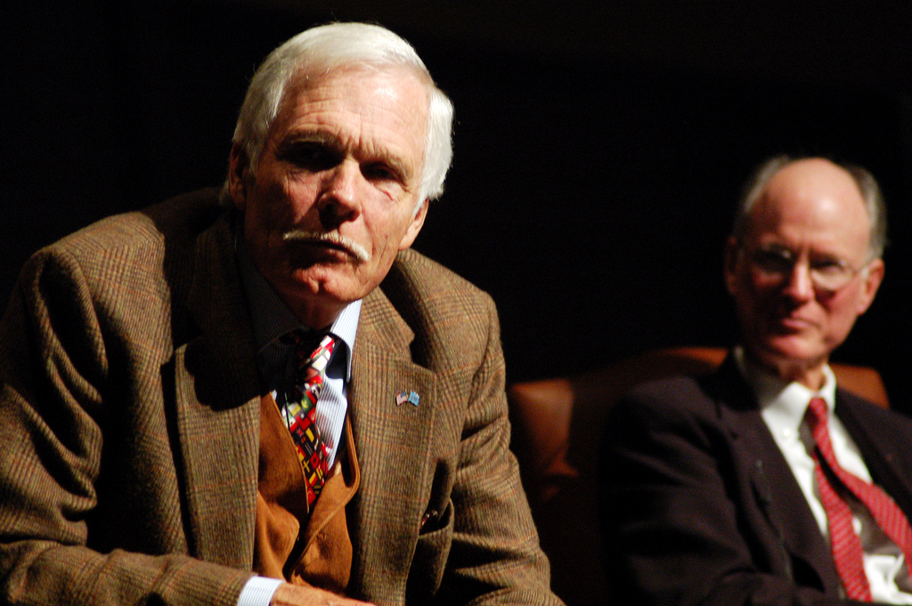
WHAT TELEVISION
LOOKS LIKE

Slide 20
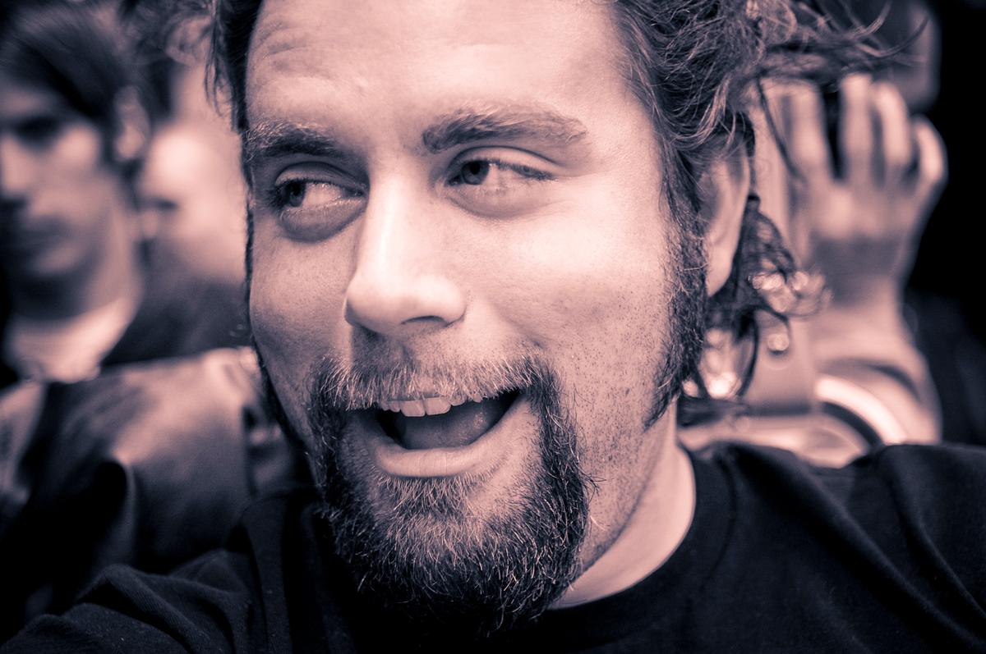
WHAT IF TELEVISION
LOOKED LIKE THIS

Slide 21
WHAT IF TELEVISION
LOOKED LIKE THIS
YOU

Slide 22
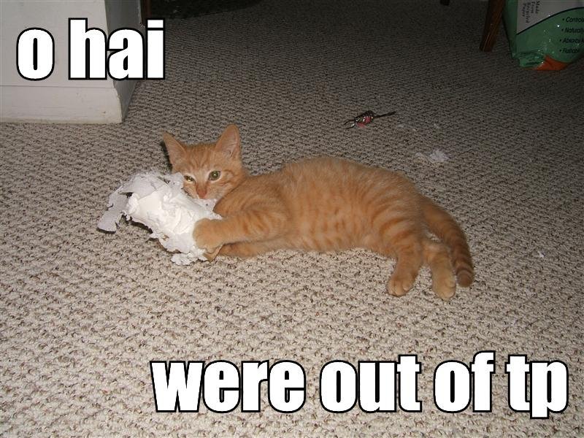
INTRODUCTIONS ARE
DIFFICULT TO ILLUSTRATE

Slide 23
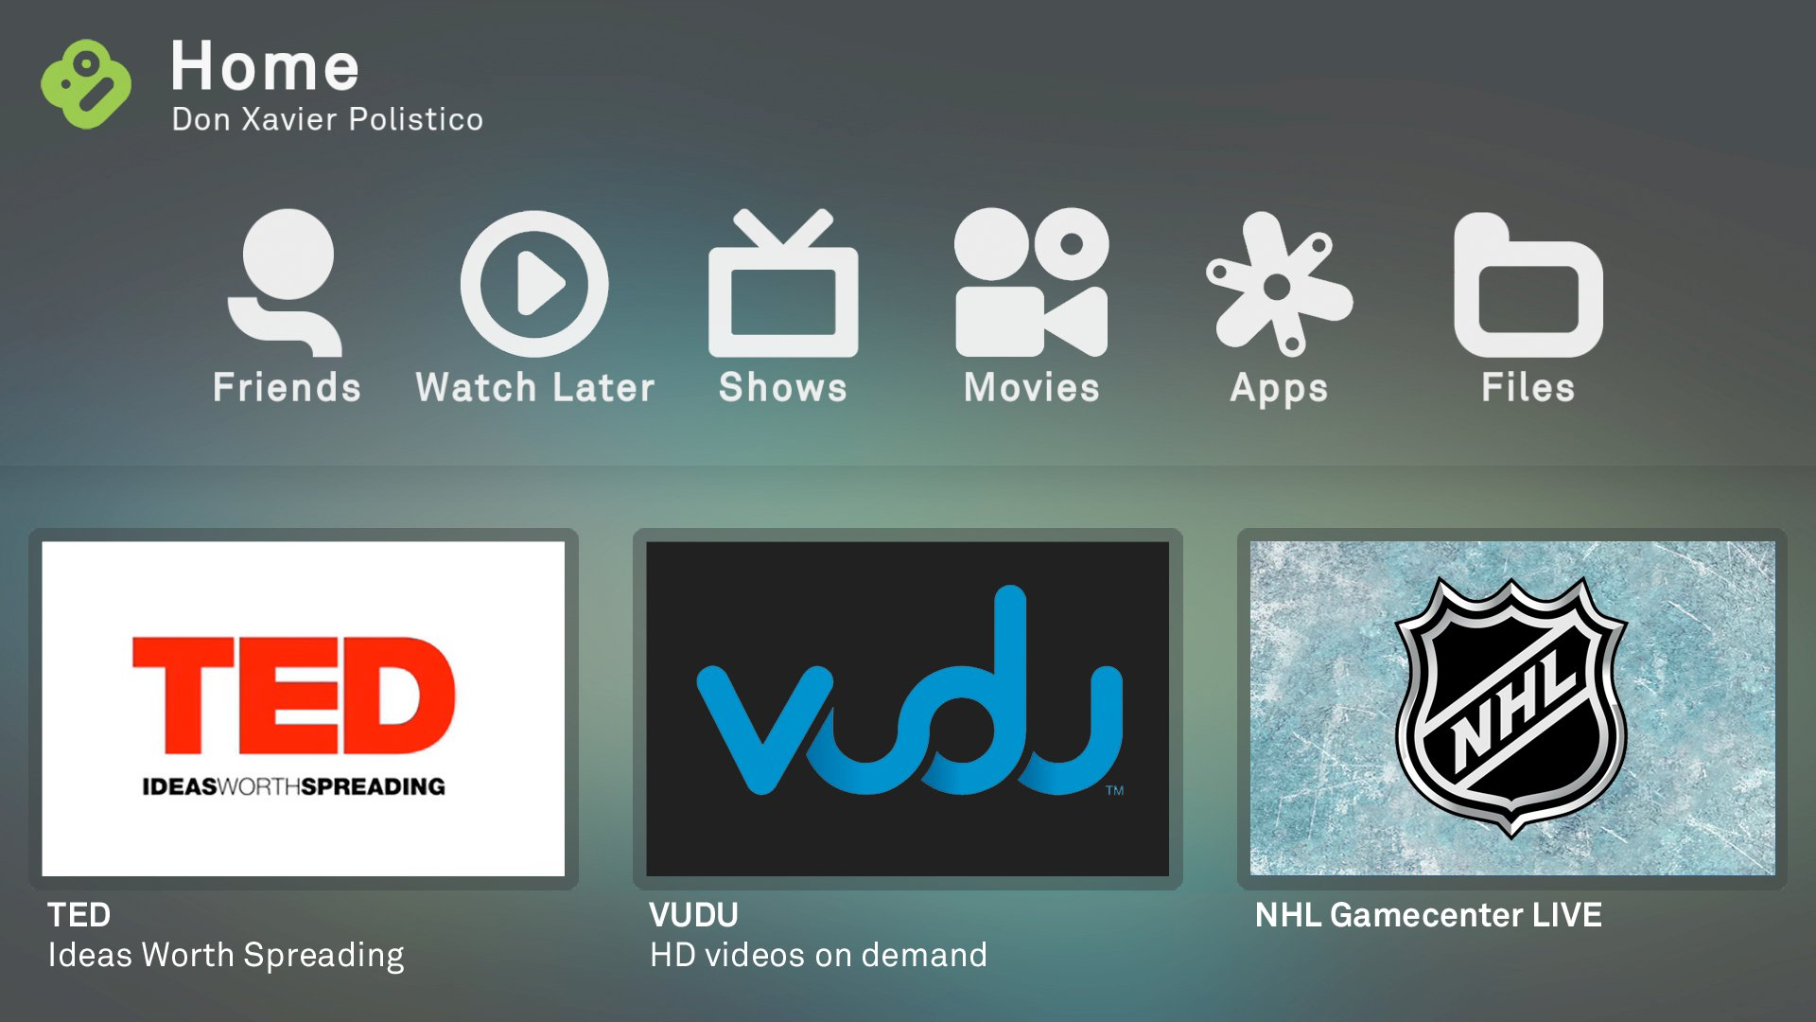
BOXEE
OPEN SOURCE SOCIAL MEDIA CENTER

Slide 24
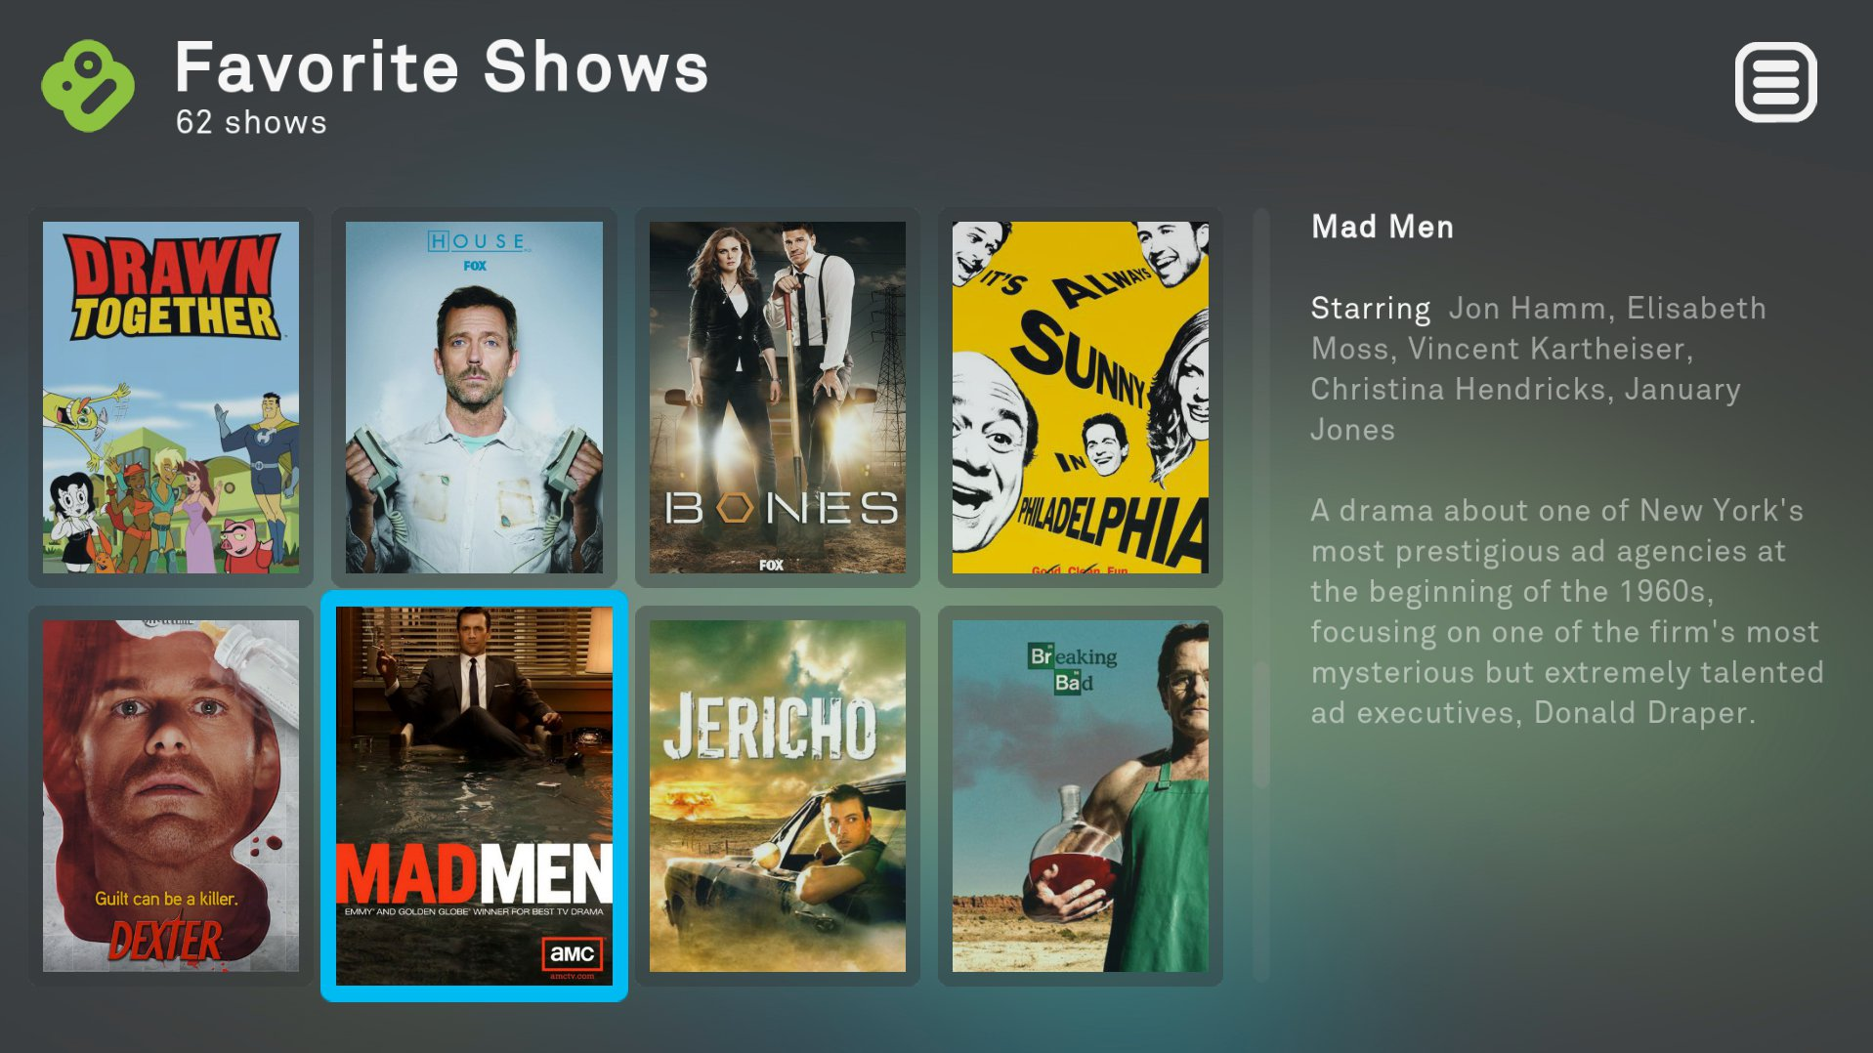
CONVERGENCE
IS AWESOME

Slide 25
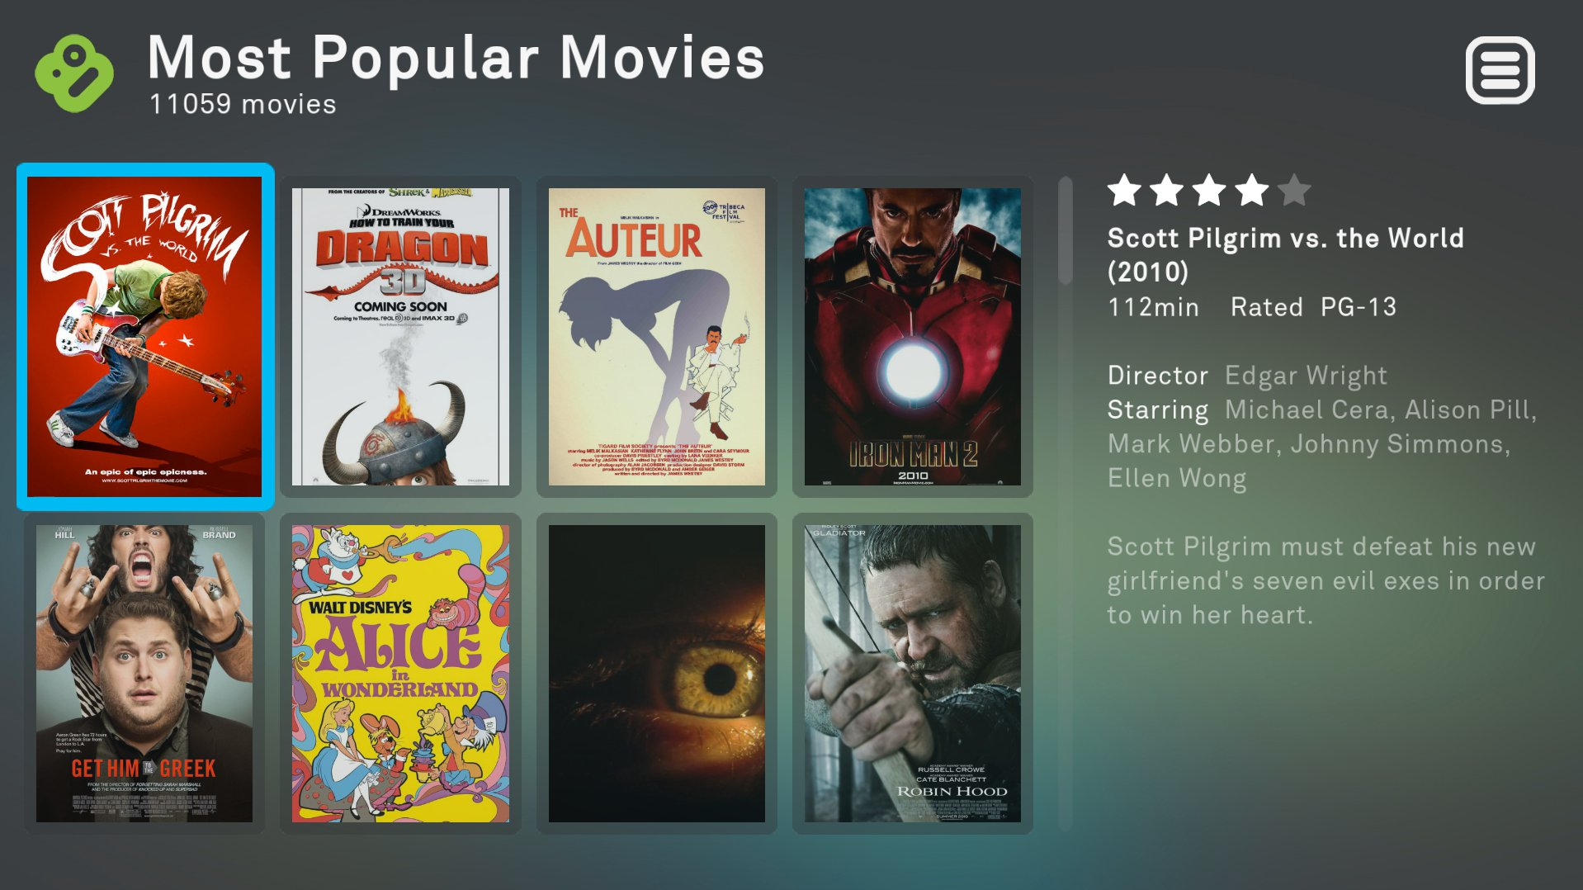
CONVERGENCE
IS AWESOME

Slide 26
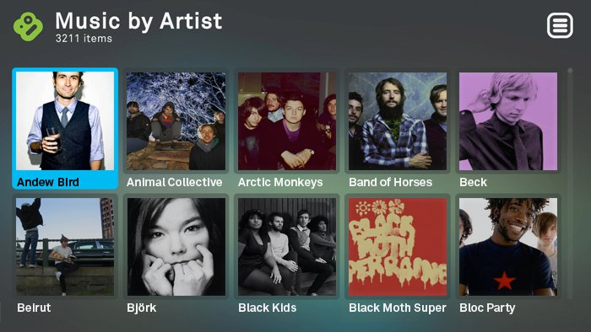
CONVERGENCE
IS AWESOME

Slide 27
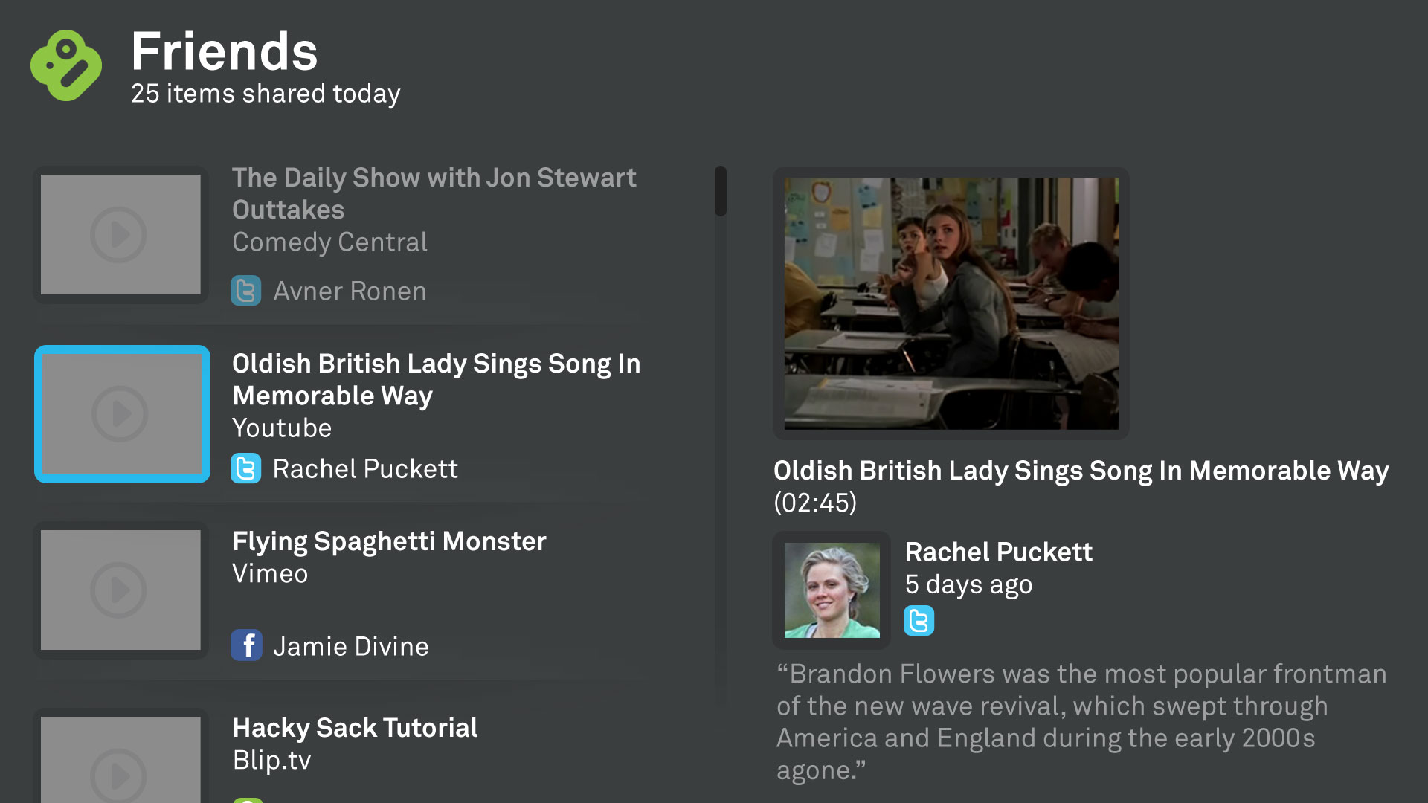
SOCIAL
IS EVEN MORE AWESOME

Slide 28
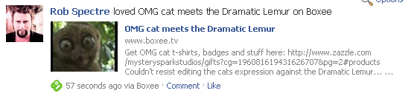
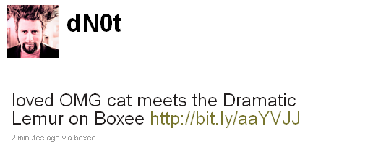
SOCIAL
IS EVEN MORE AWESOME

Slide 29

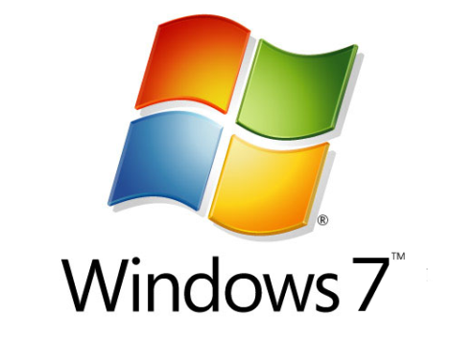

PLATFORMS
PWN-UR-FACE AWESOME

Slide 30
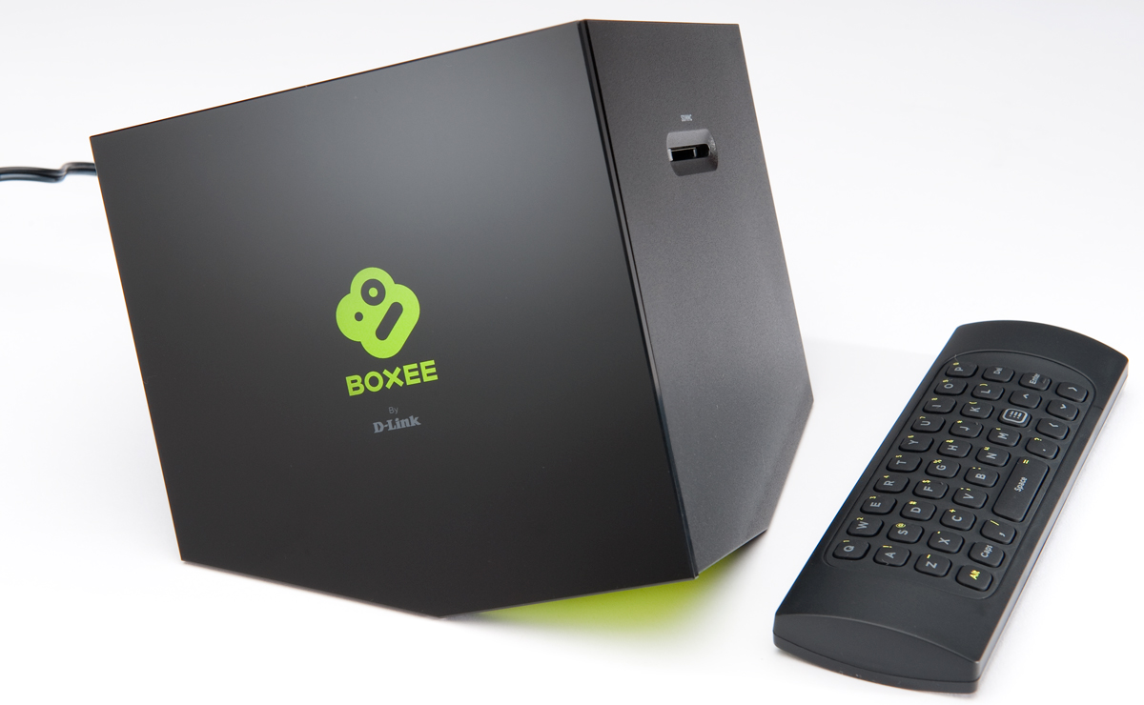
PLATFORMS
PWN-UR-FACE AWESOME

Slide 31
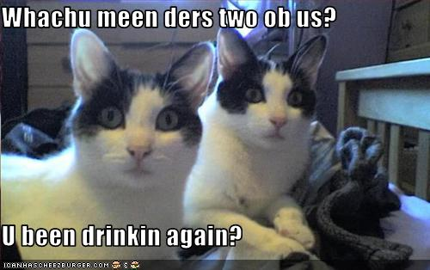
TWO TASTY WAYS
TO CHANGE TV

Slide 32
THE SKINNY
ON SKIN APPS
SUPER EASY
ALL PLATFORMS
PYTHON

Slide 33
THE JIVE
ON HTML5
SUPER POWERFUL
OTHER PLATFORMS
BOXEE BOX ONLY

Slide 34
SCREW THIS HIPPIE NOISE
SHOW ME CODE
<?xml version="1.0"?>
<window type="window" id="14000">
<defaultcontrol always="true">100</defaultcontrol> <allowoverlay>no</allowoverlay>
<controls>
<control type="group">
<control type="image">
<posx>0</posx>
<posy>0</posy>
<width>1280</width>
<height>720</height>
<texture>lolcat.png</texture>
</control>
</control>
</controls>
</window>

Slide 35
SKIN APP CONTROLS
OMG!
BUTTONS
INPUT
LABELS / IMAGES
SCROLLBAR
LISTS
VISUALIZATION / VIDEO

Slide 36
USING PYTHON EVENTS
FOR FUN AND PROFIT
ONLOAD
ONUNLOAD
ONFOCUS
ONCLICK
DIRECTIONAL (UP, UP, DOWN, DOWN)

Slide 37
HAVE SOME
DELICIOUS CAKE
<control type="button" id="1000">
<width>88</width>
<height>39</height>
<label>Example! LOL</label>
<align>center</align>
<textcolor>ffffffff</textcolor>
<onclick lang="python"> <![CDATA[
mc.ShowDialogNotification('Hello World!')
]]> </onclick>
</control>

Slide 38
GO TO SCHOOL
TAKE SOME CLASSES
APP
WINDOW
CONTROLS
PLAYLIST
PLAYER
HTTP

Slide 39
FAMILIAR FACES
FOR FREE
urllib, urllib2
httplib
pickle
minidom
simplejson
OR BRING YOUR OWN

Slide 40
GET HTML5 WIRED IN
TO SOME TASTINESS
<app>
<id>example</id>
<name>Example HTML5 App</name>
<version>1.0</version>
<description>An example HTML5 app using the new Boxee browser.</description>
<thumb>http://example.com/thumbnail.png</thumb>
<repository>http://dir.boxee.tv/apps</repository>
<media>video</media>
<copyright>Example, inc</copyright>
<type>html</type>
<url>http://www.example.com/html5app</url>
<controller>http://dir.boxee.tv/apps/js/kb-mode.js</controller>
<platform>all</platform>
<minversion>1.0</minversion>
</app>

Slide 41

GITHUB.COM/RobSpectre/Talks
@BOXEE_API
#BOXEE
DEVELOPER.BOXEE.TV
/blog

Slide 42
THANK
YOU!

Slide 43
QUES TIONS?

